Slide 1
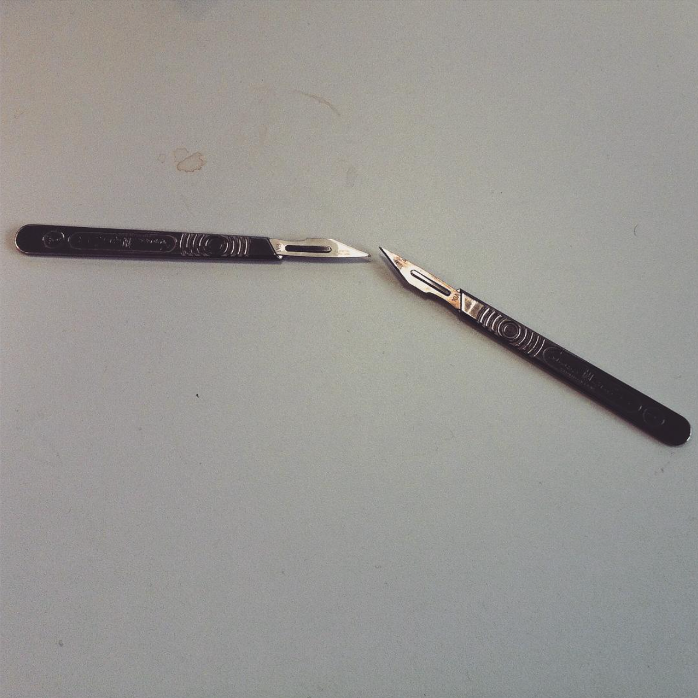
Procrastination:
preparation
perfection
and excuses.
Joanne Lee
@generalistjo

Slide 2
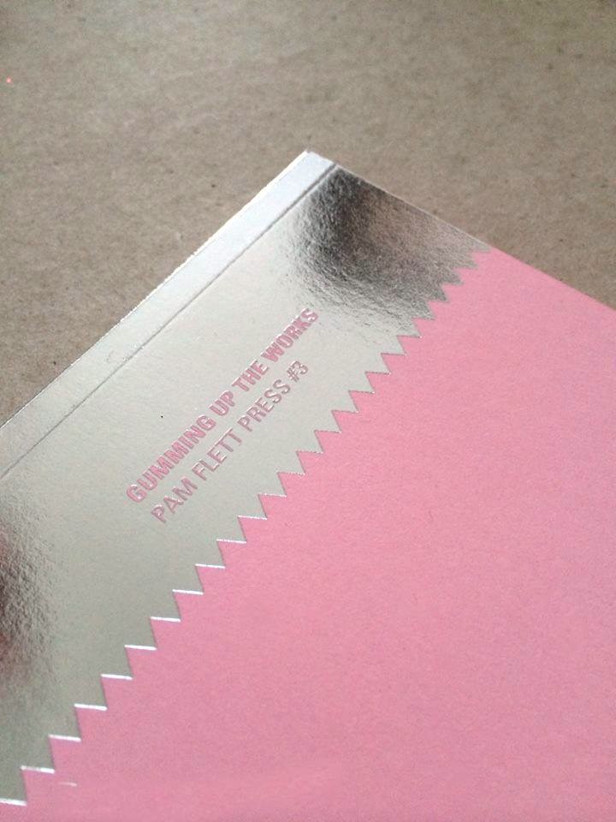
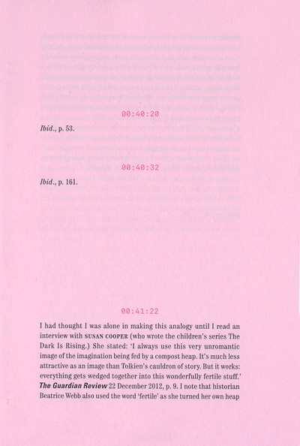

Slide 3
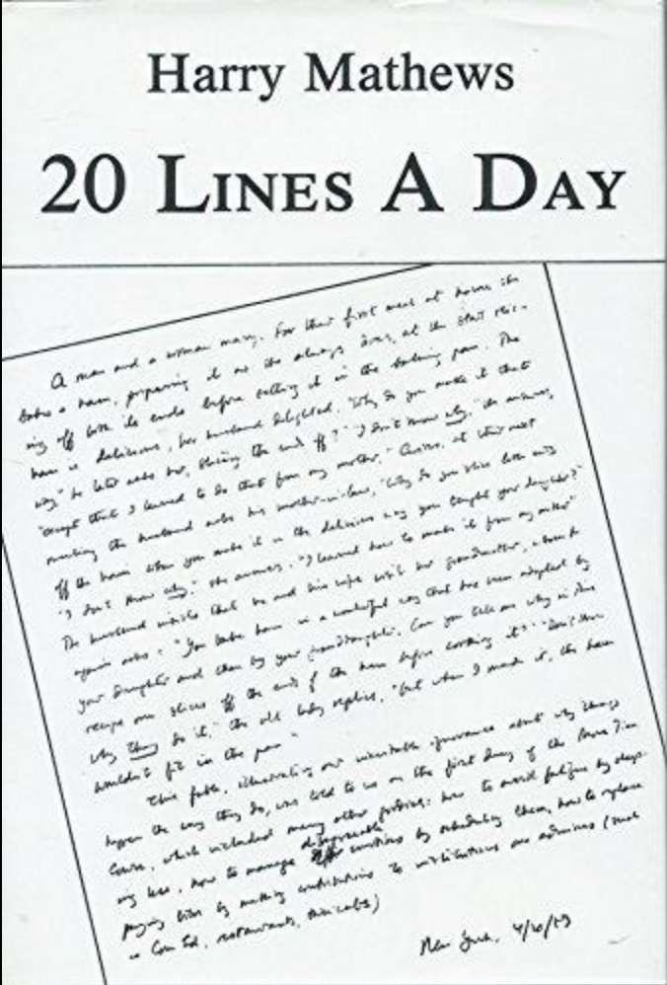

Slide 4
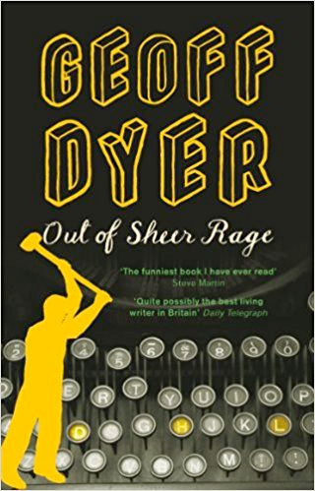

Slide 6
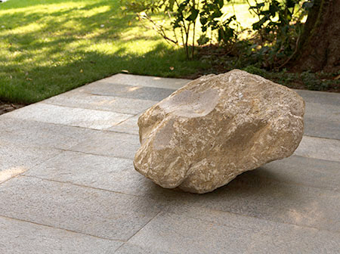
‘I know about creative block and I know not to call it by name’ Ryan Gander

Slide 7
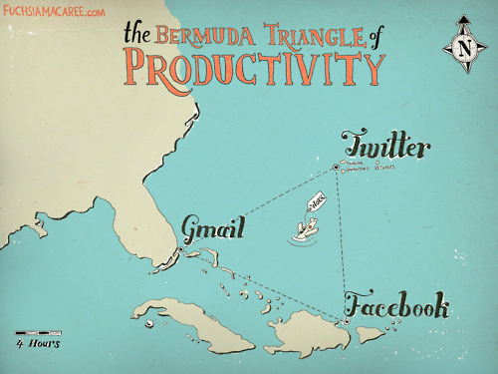

Slide 8
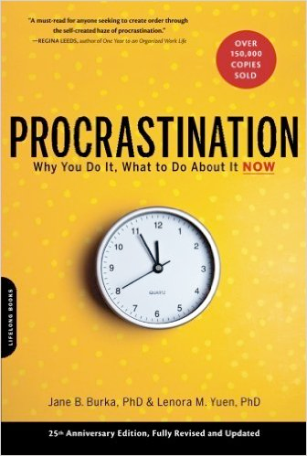

Slide 9
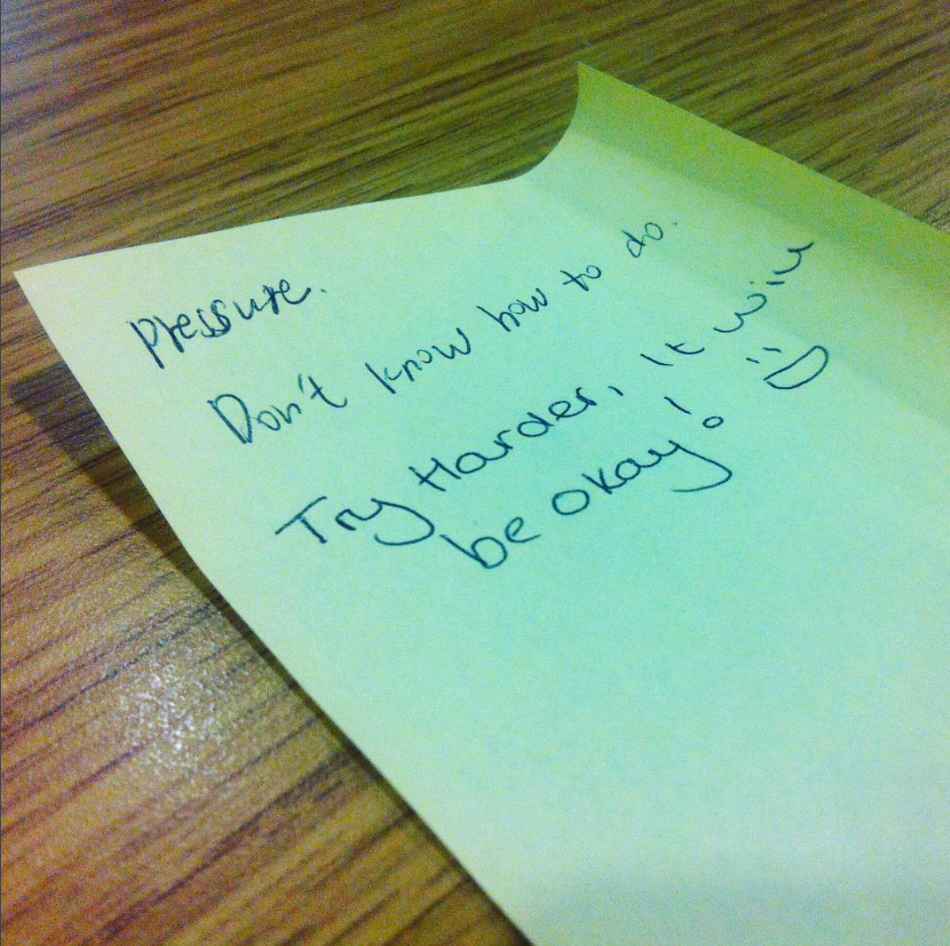

Slide 10
The Procrastinator’s Code
I must be perfect.
Everything I do should come easily and without effort.
It’s safer to do nothing than to take a risk and fail.
I should have no limitations.
If it’s not done right, it’s not worth doing at all.
I must avoid being challenged.
If I succeed, someone will get hurt.
If I do well this time, I must always do well.
Following someone else’s rule means I’m giving in and I’m not in control.
I can’t afford to let go of anything or anyone.
If I show my real self, people won’t like me.
There is a right answer and I’ll wait until I find it.

Slide 11
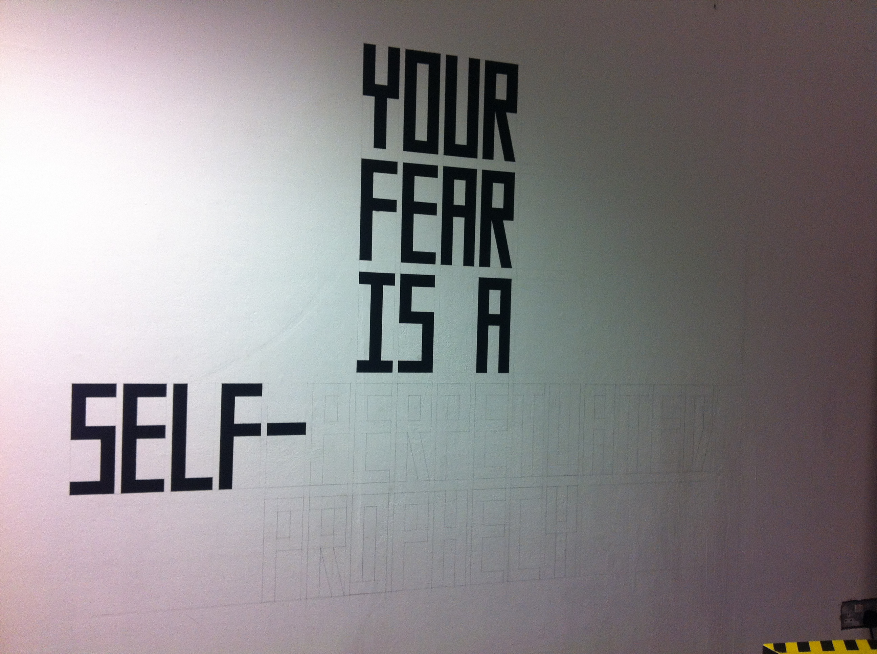

Slide 13
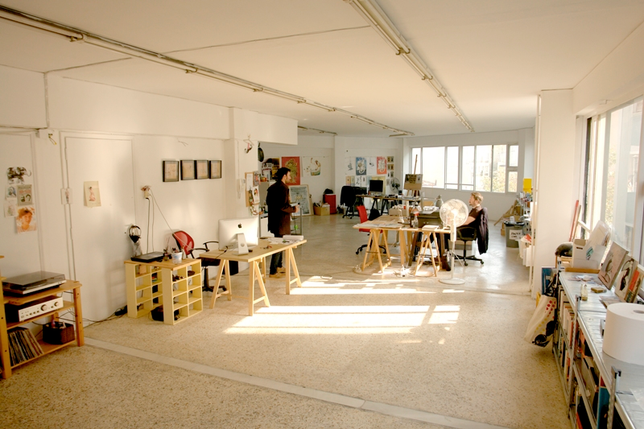

Slide 14
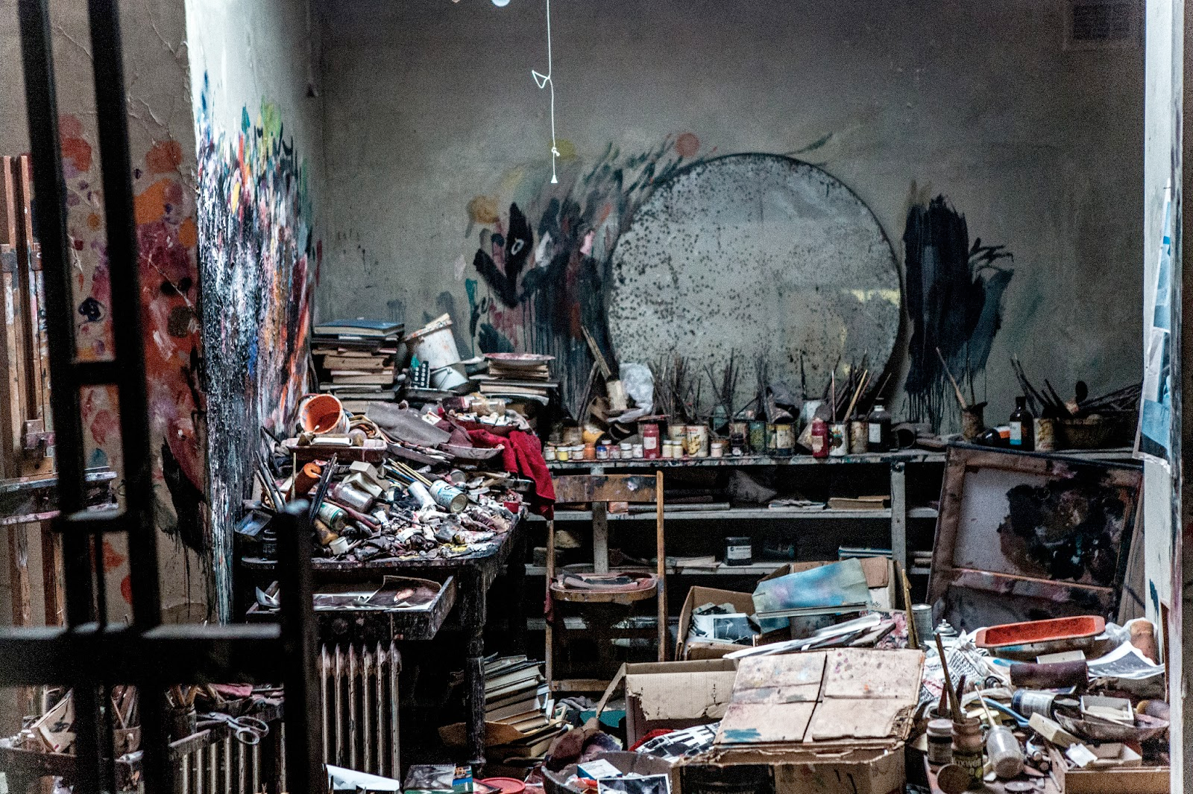

Slide 15
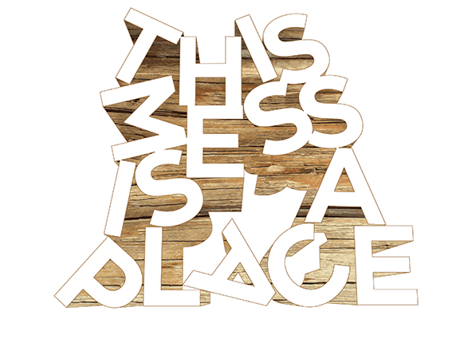
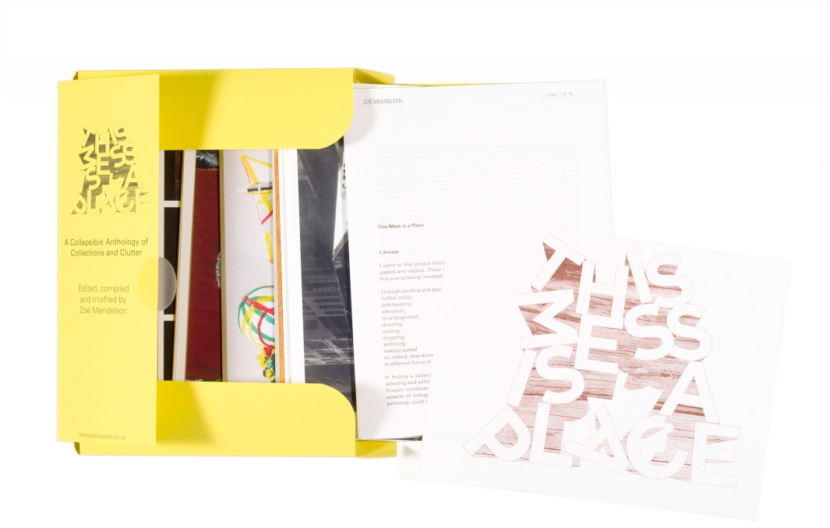
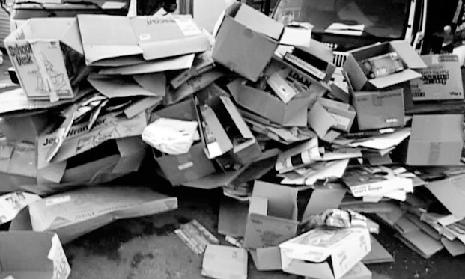
Zoe Mendelson

Slide 17
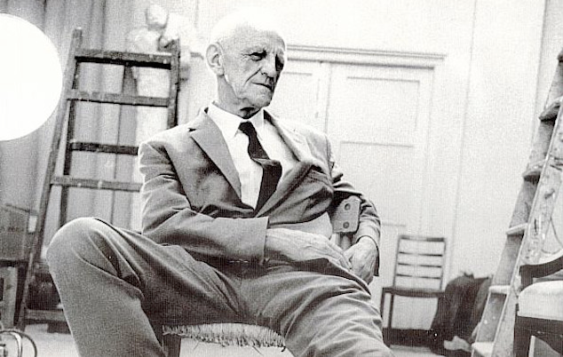
D. W. Winnicott - ‘good enough’ parent

Slide 18
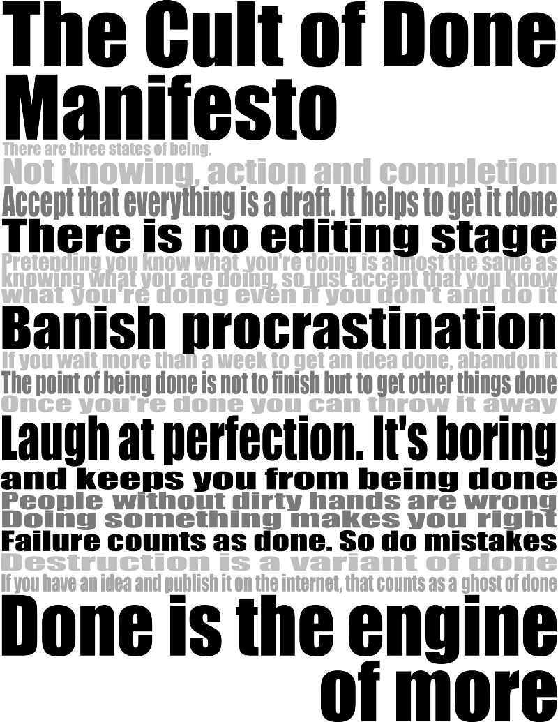

Slide 19
If I show my real self, people won’t like me.
Following someone else’s rule means I’m giving in and I’m not in control.

Slide 20
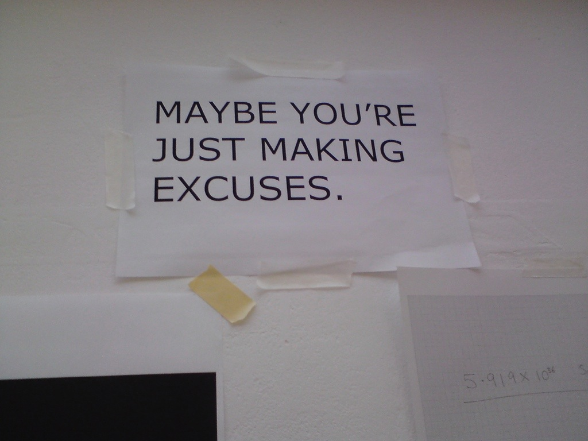
Common excuses for procrastinating…

Slide 21
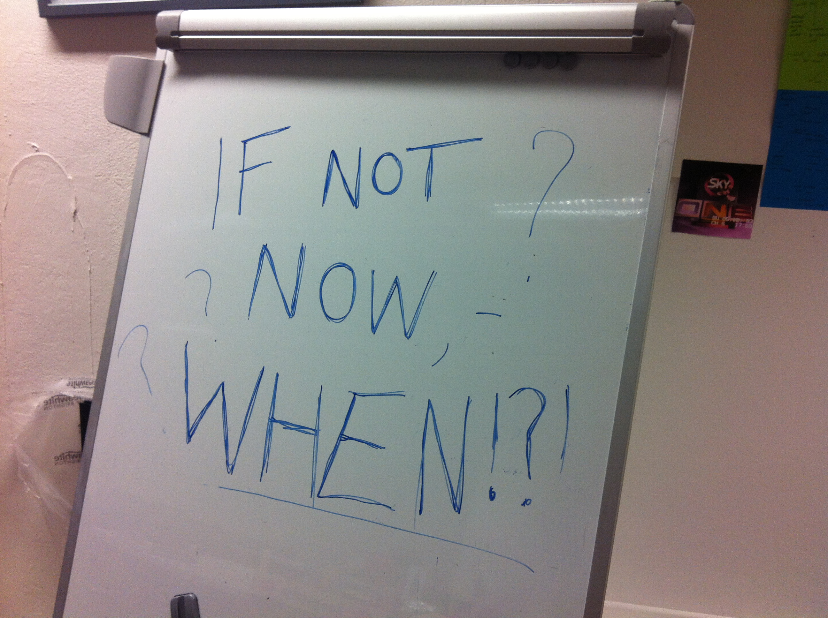
I don’t feel well;
I’m too tired right now;
I’m not in the mood.

Slide 22
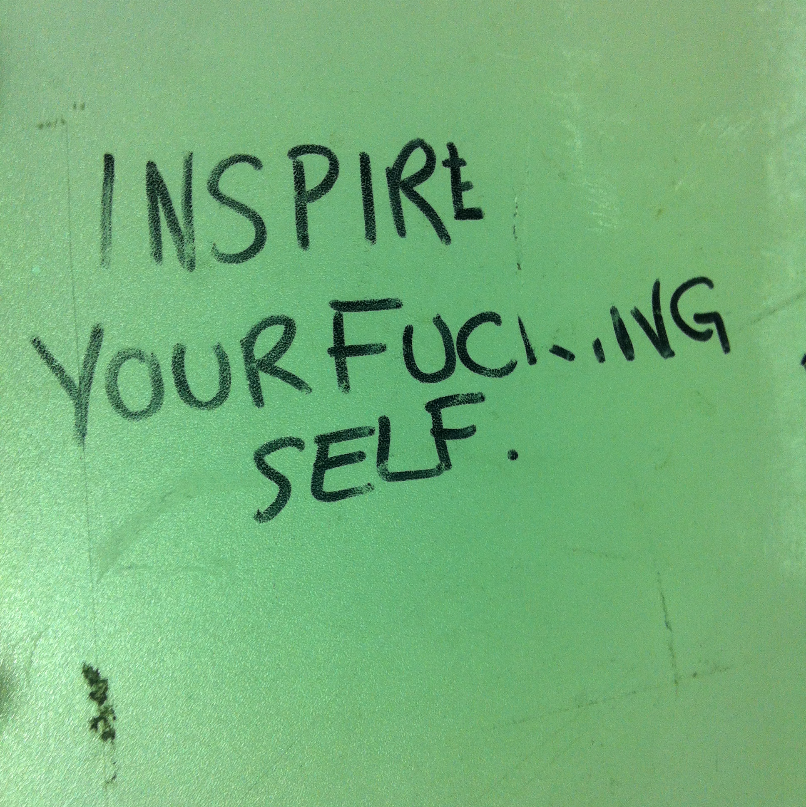
I’ll wait until I’m inspired.

Slide 23
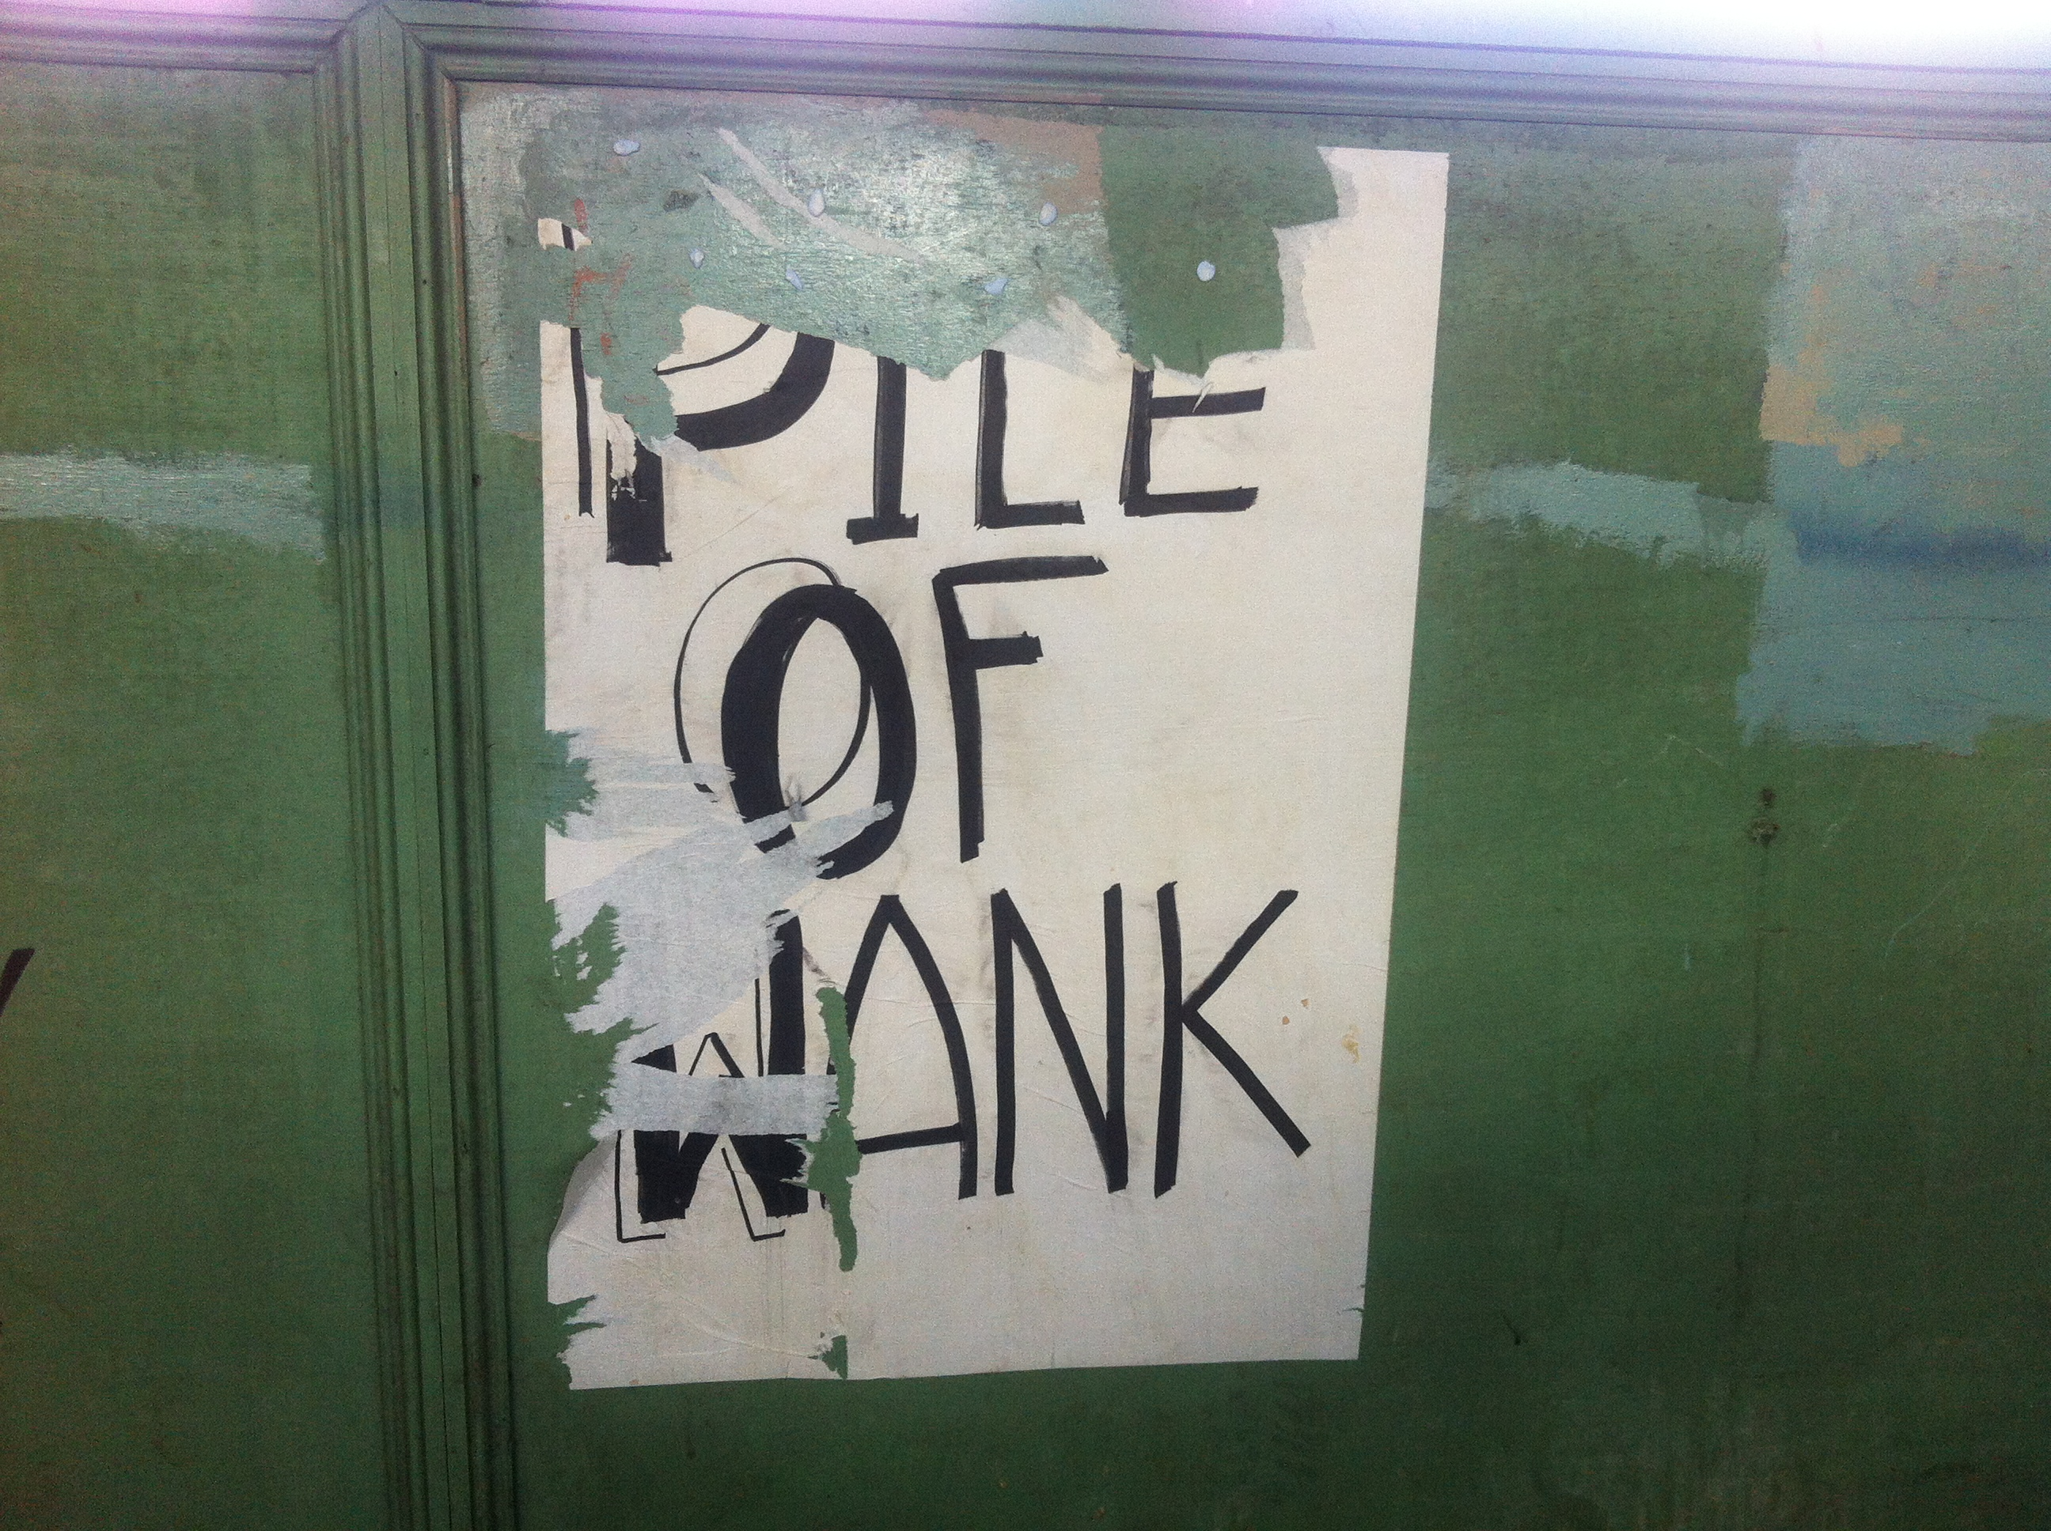
It might not be good enough.

Slide 24
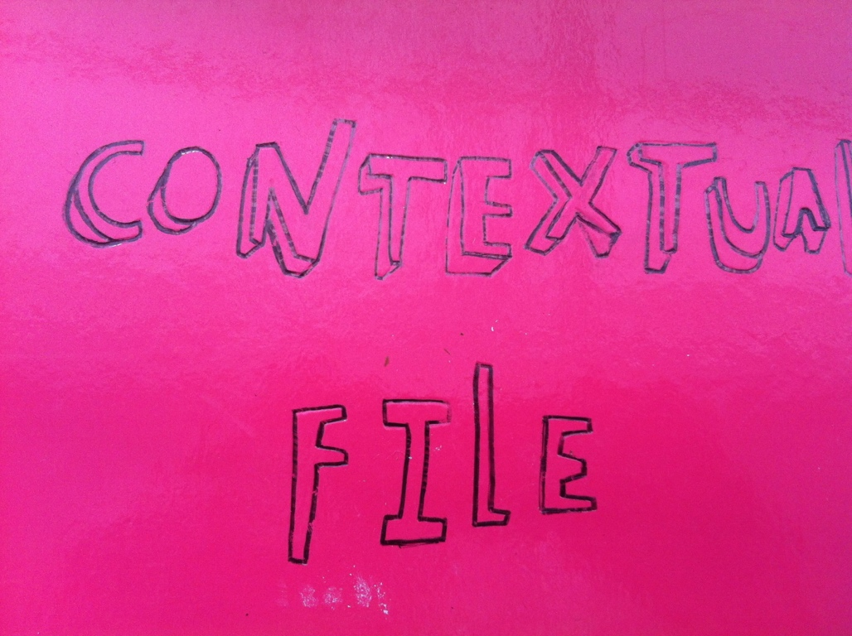
If I wait,
I can do a really first class job.

Slide 25
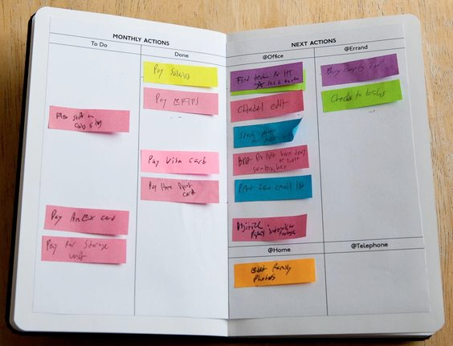
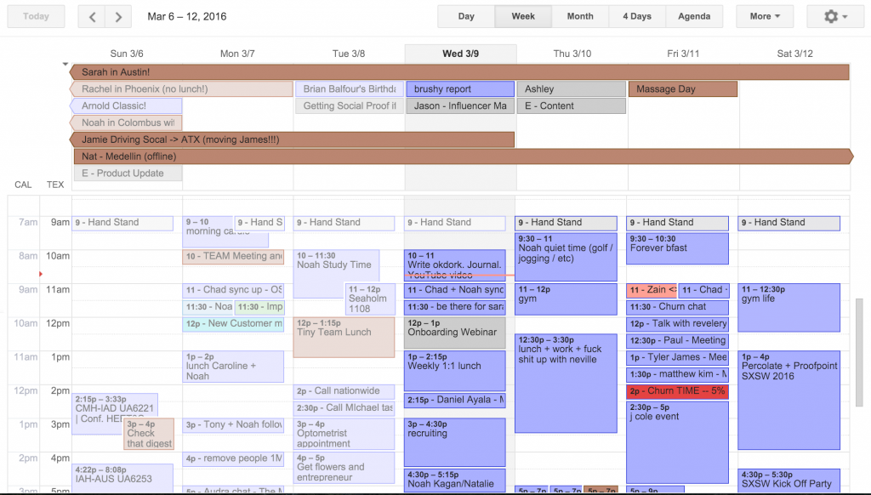
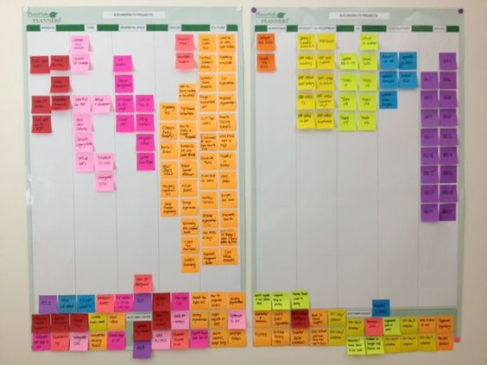
I’ve got to get organised first;
I don’t have everything I need.

Slide 26
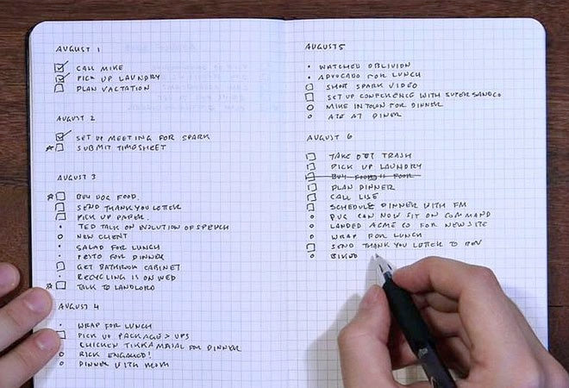
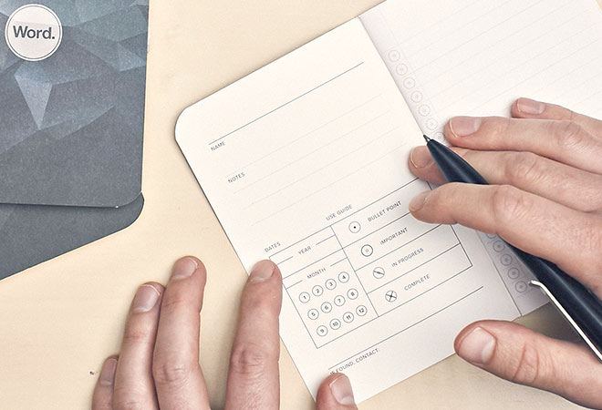
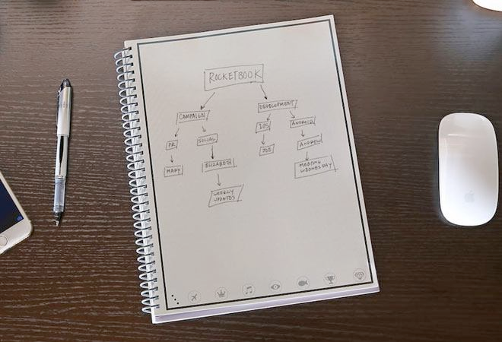
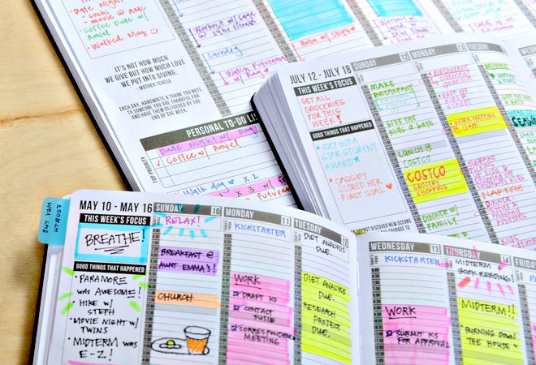
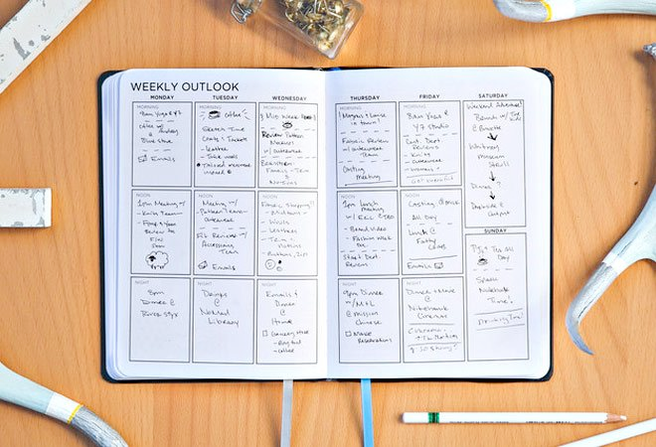
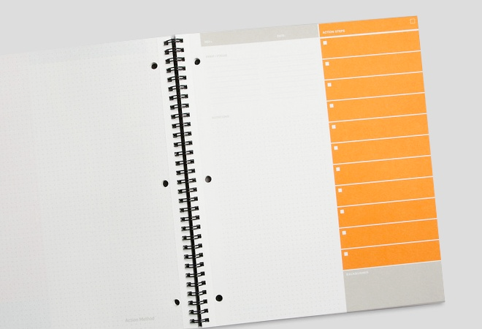

Slide 27
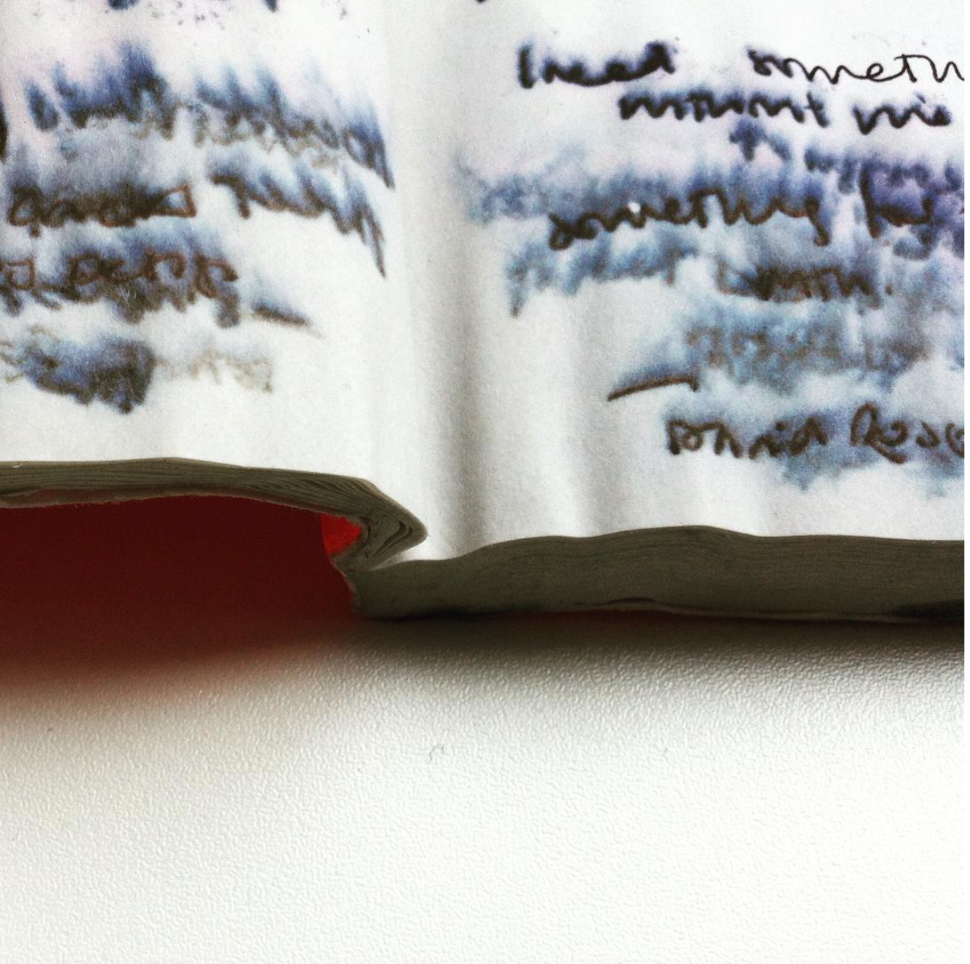

Slide 28
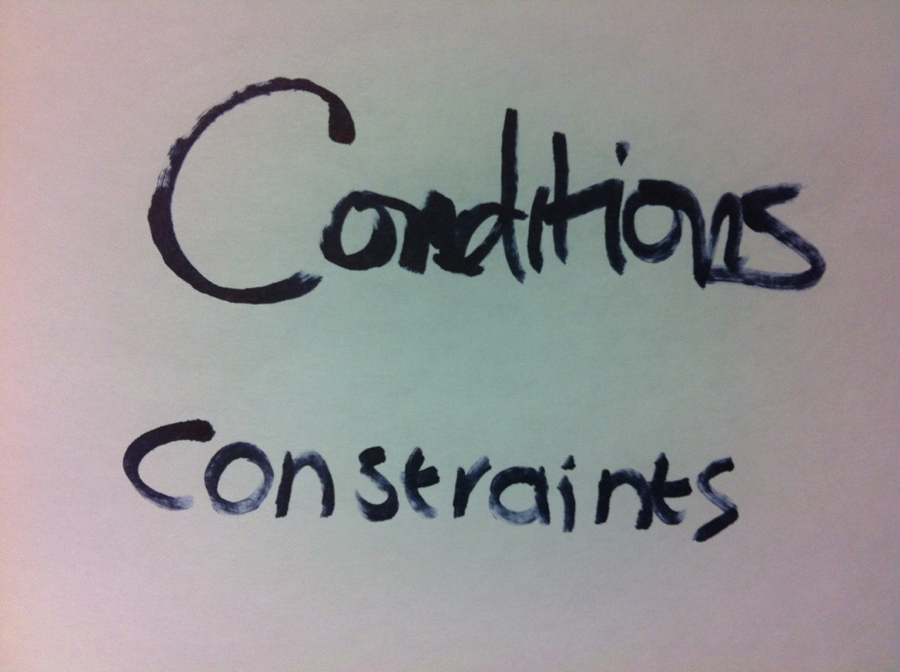
I don’t have time to do this now,
so there’s no point in starting.

Slide 29
It’s too late in the week to start.
I’ll have more time at the weekend.
It won’t take very long
and there’s still plenty of time.
I’ve done the worst part of it;
the final step will be a breeze.

Slide 30
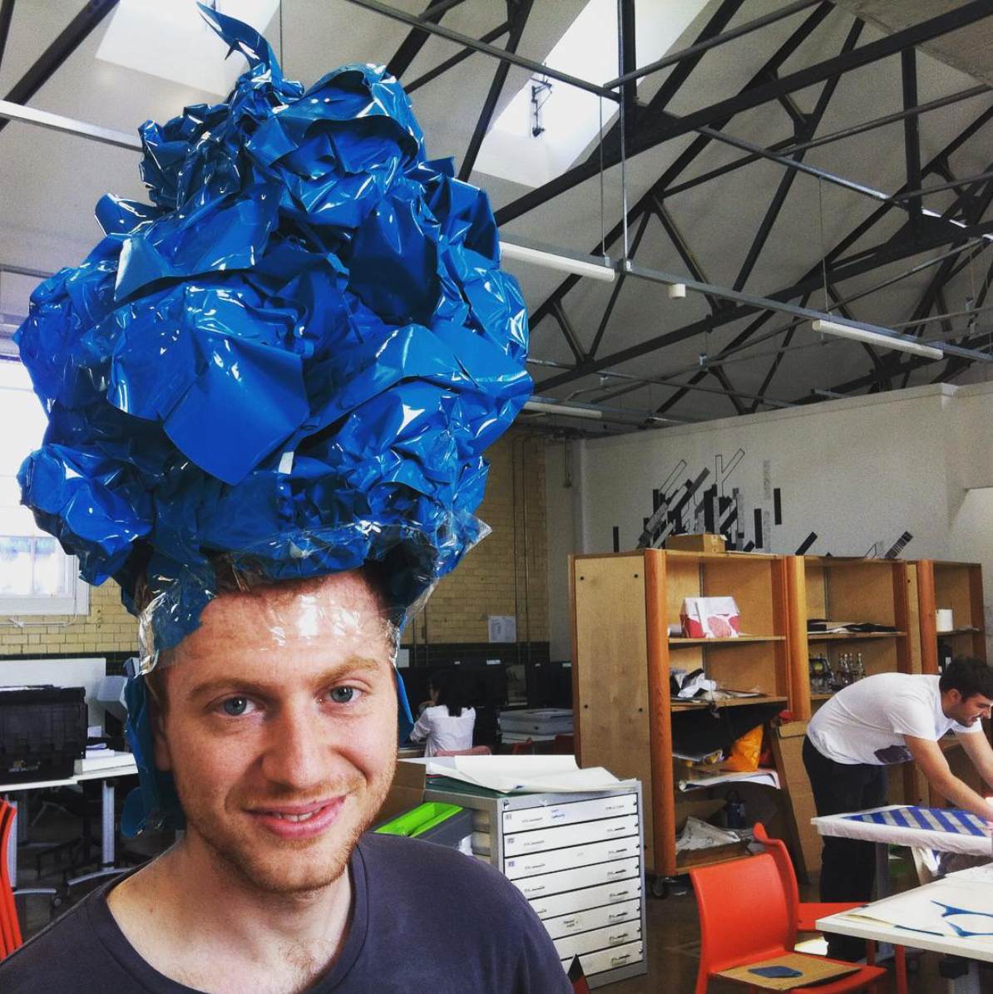
I’ve been working so hard
- I deserve a break.

Slide 31
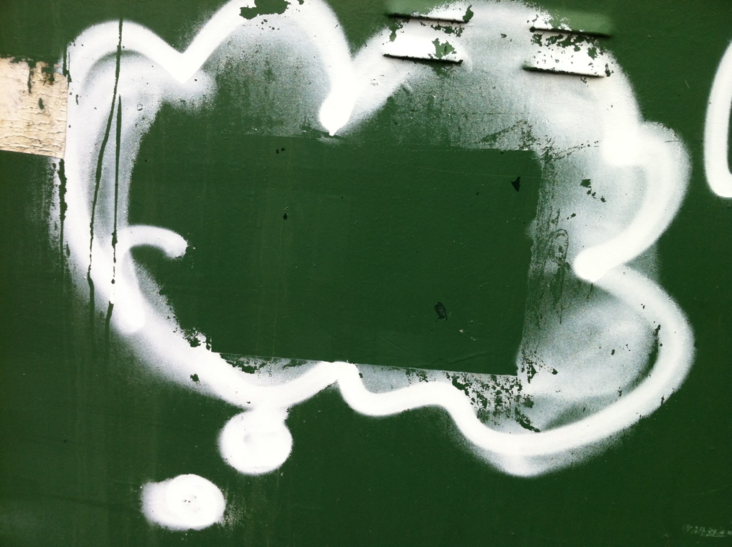

Slide 32
It might not be good enough, but I’ll give it a try anyway.
I’m tired. I’ll just work for fifteen minutes and then I’ll go to bed.
This may not turn out perfectly, but I’ll learn a lot from doing it.
I don’t have the proper equipment, but is there something I can do anyway?
I don’t have enough time to finish now - but I’ll spend fifteen minutes on it.
This is going to be hard, so I’d better leave enough time to work out the problems.

Slide 33
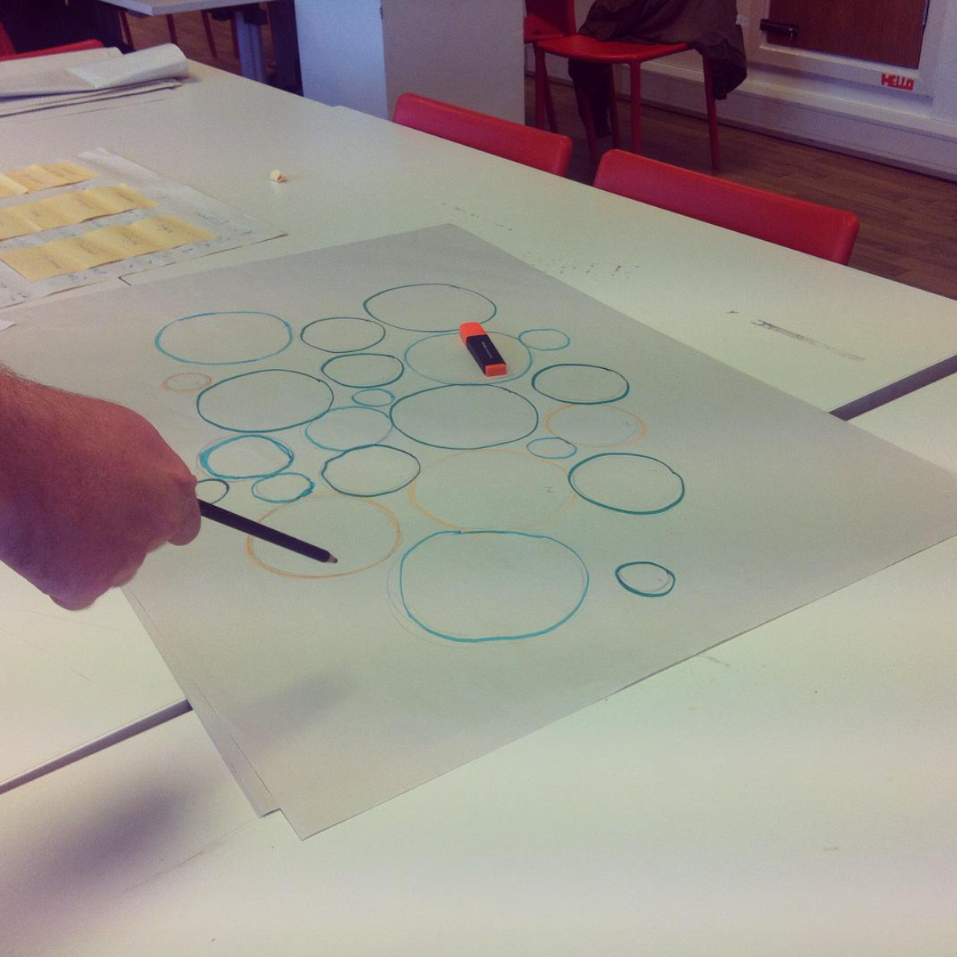
Alan Lakein ‘Swiss cheese’ method of time management.
Poke holes in a task by using little bits of time rather than waiting for a long block.

Slide 34
