Slide 1
Coventry Biennial of Contemporary Art SWOT Analysis
Ryan Hughes On the occasion of CVAN EM’s Another World is Possible

Slide 2
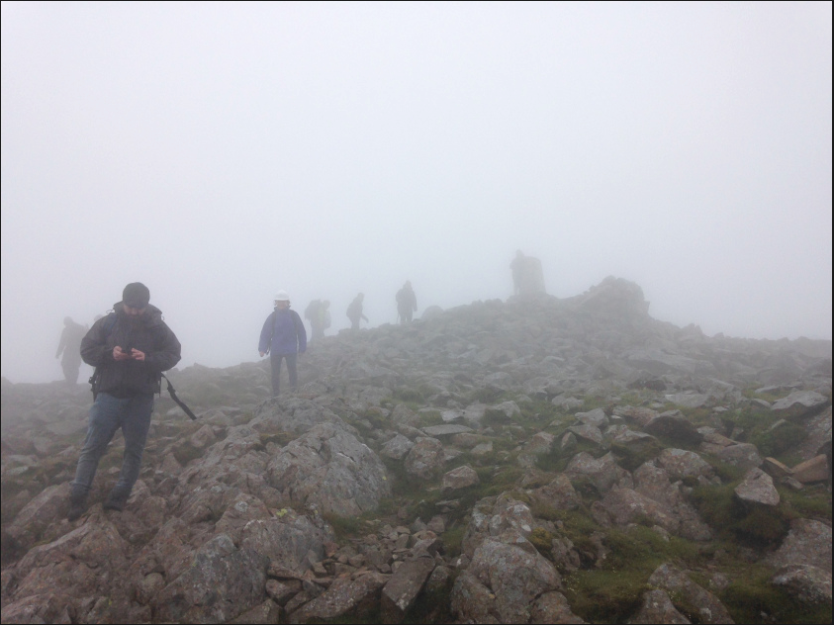
Nomadic Village // Pentref Crwydrol. Cader Idris, 2016

Slide 3
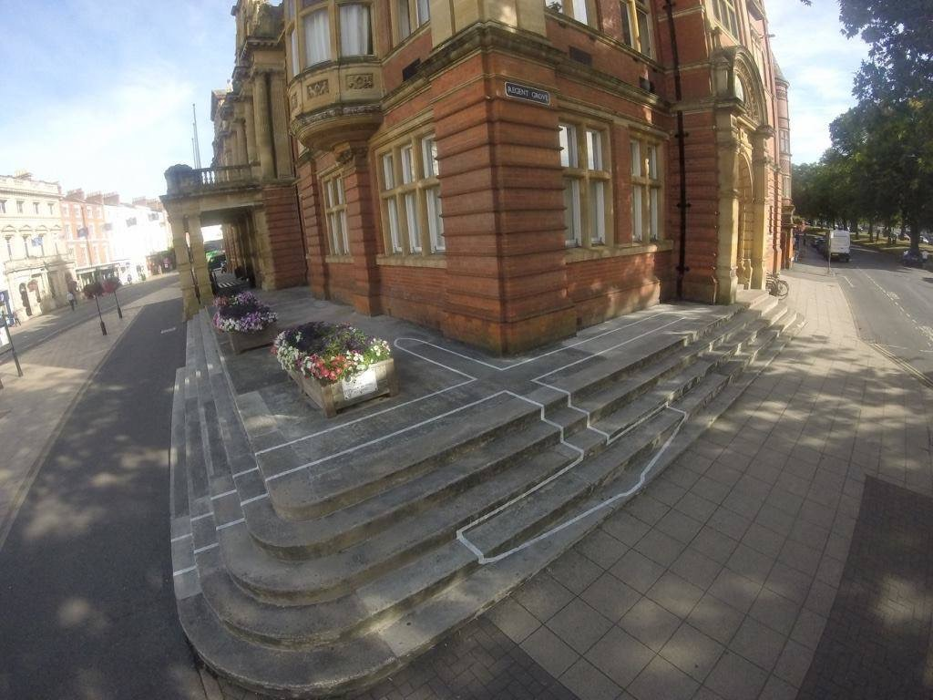
James Bridle, Drone Shadow. Leamington Spa Town Hall, 2016

Slide 4
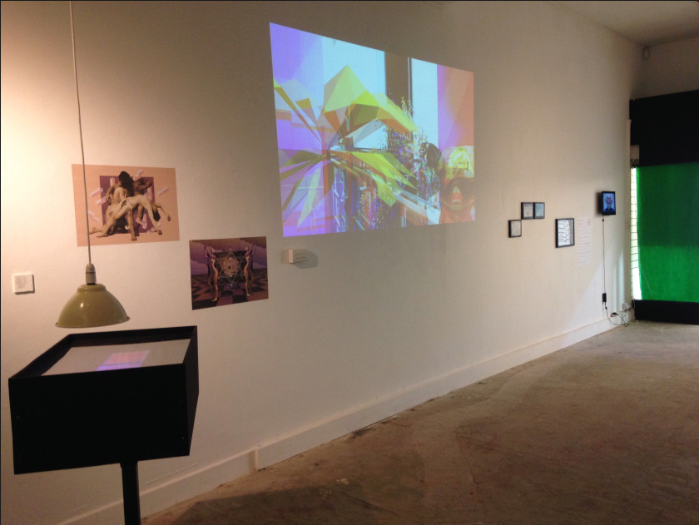
#ArtistsCompute2016. City Arcadia Gallery, 2016

Slide 5
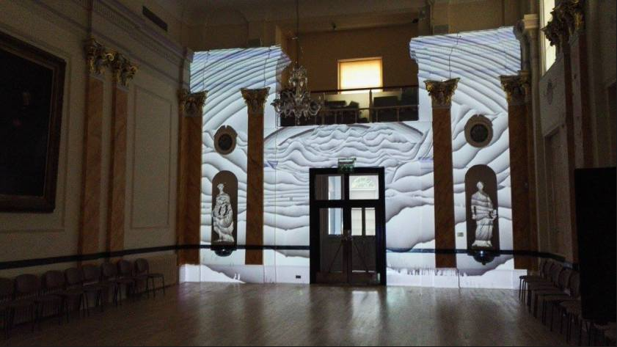
The Disrupted/Disruptive Pattern. Royal Pump Rooms, 2016

Slide 6
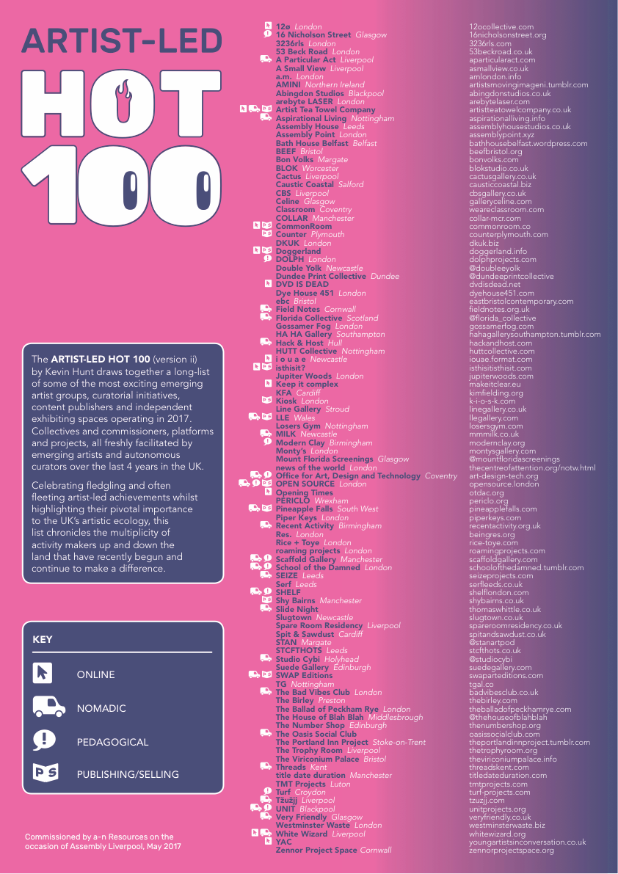
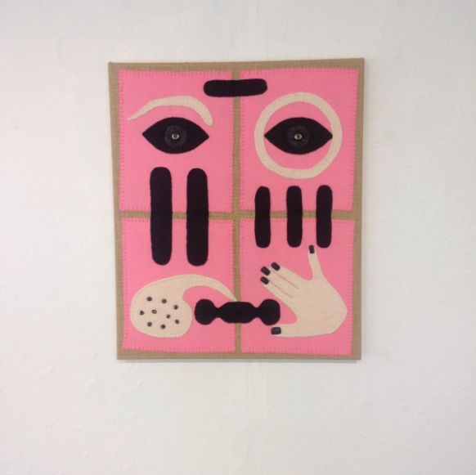
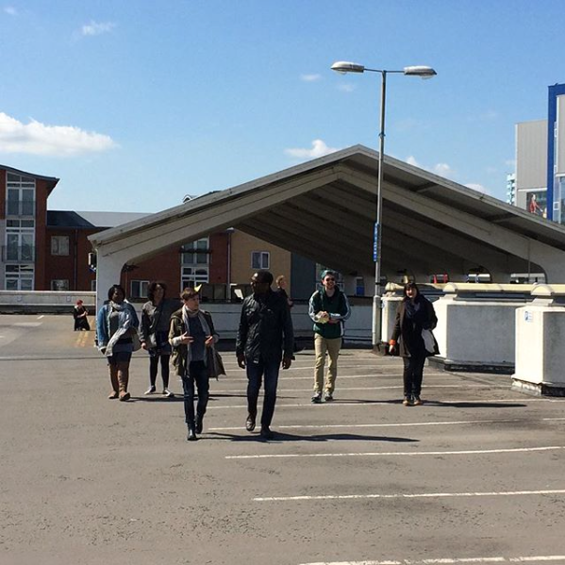
Jonathan Baldock. Mask, Glass Box.
Repeator. Transmission, City Arcade.

Slide 7
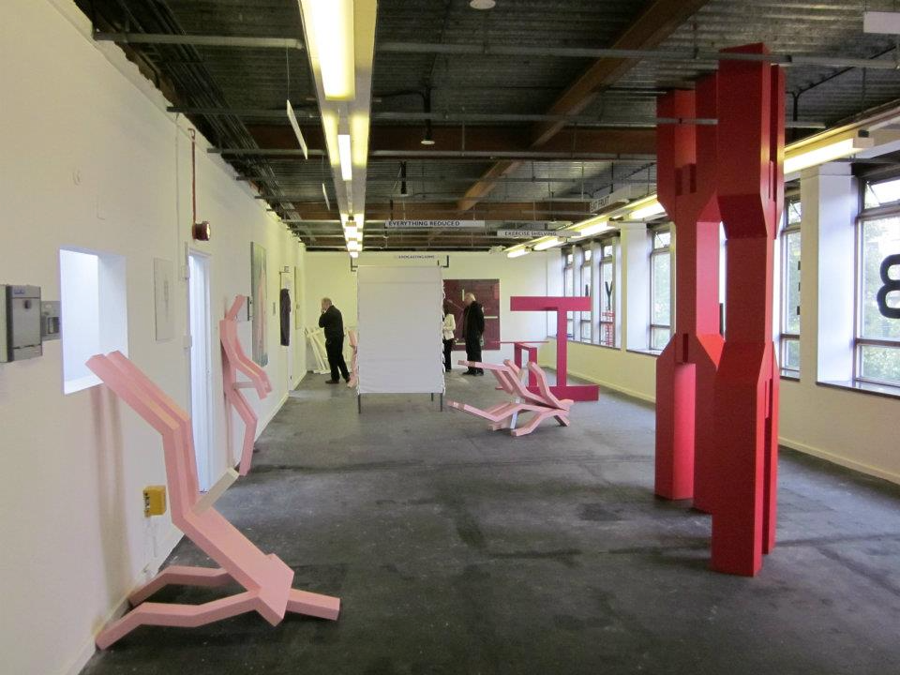
Limber Gym, Meter Rooms

Slide 8
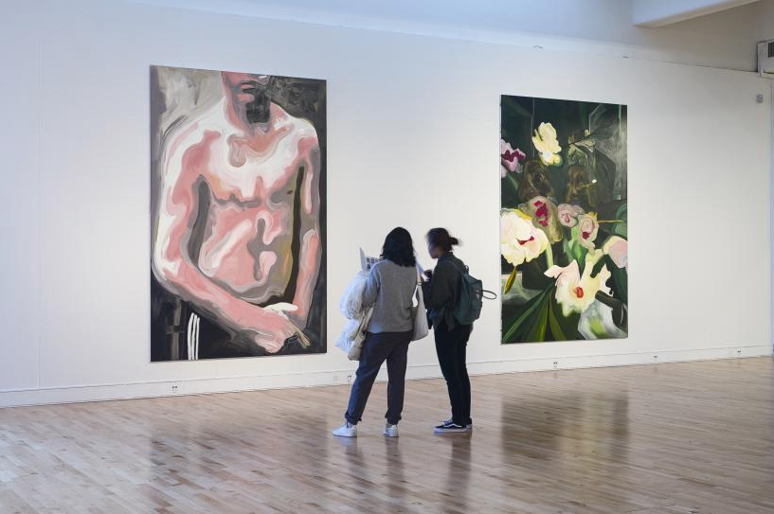
Reality Dimmed, Mead Gallery

Slide 9
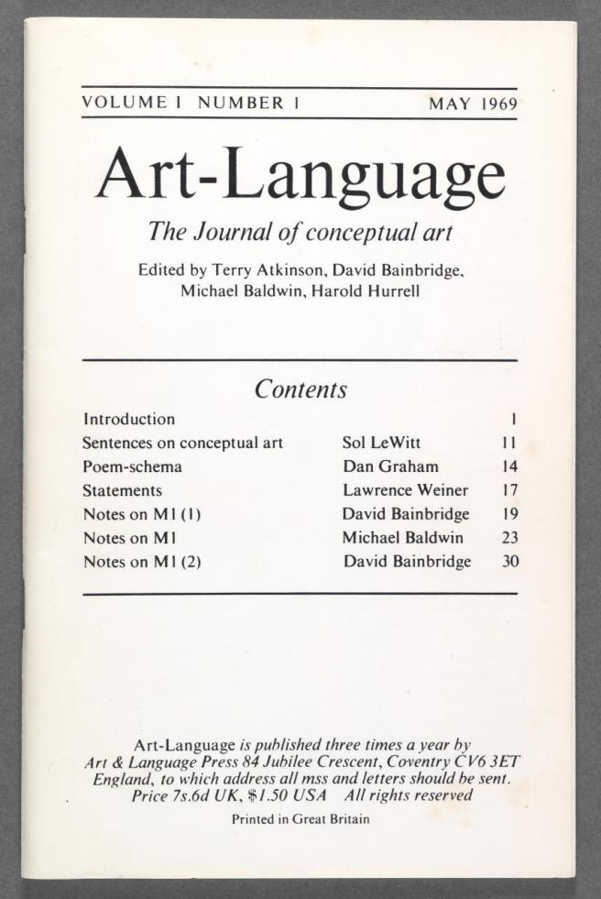

Slide 10
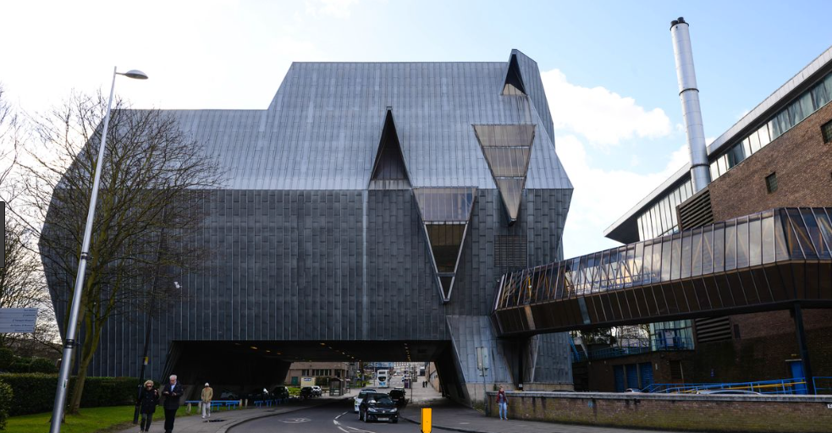

Slide 11
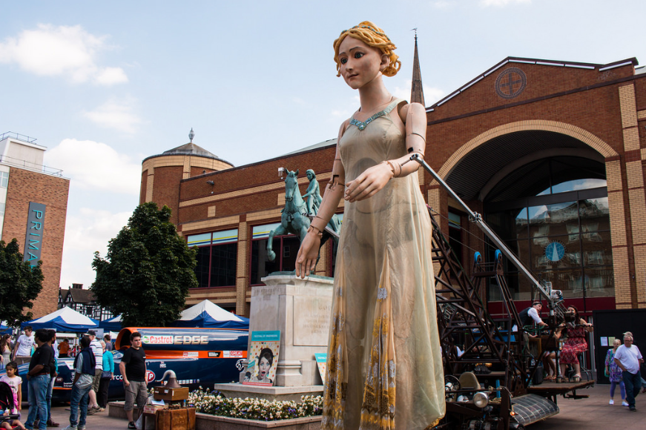

Slide 12
Goal 1 Partnership // Goal 2 Lifelong learning // Goal 3 Diversity //
Goal 4 Health and well-being // Goal 5 Economic growth

Slide 13
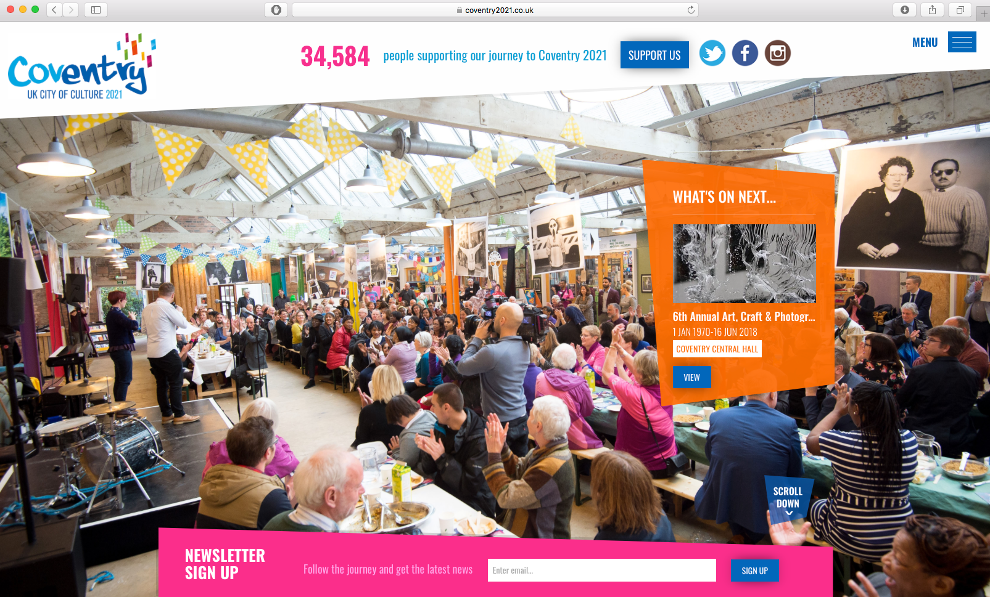

Slide 14
17 days
73 artists
13 exhibitions
60 events
£31,572.00
24009 visits across exhibitions and events
67.5% Cultural tourists 34.6% First time visitors to the city 48% Under 30 years old

Slide 15
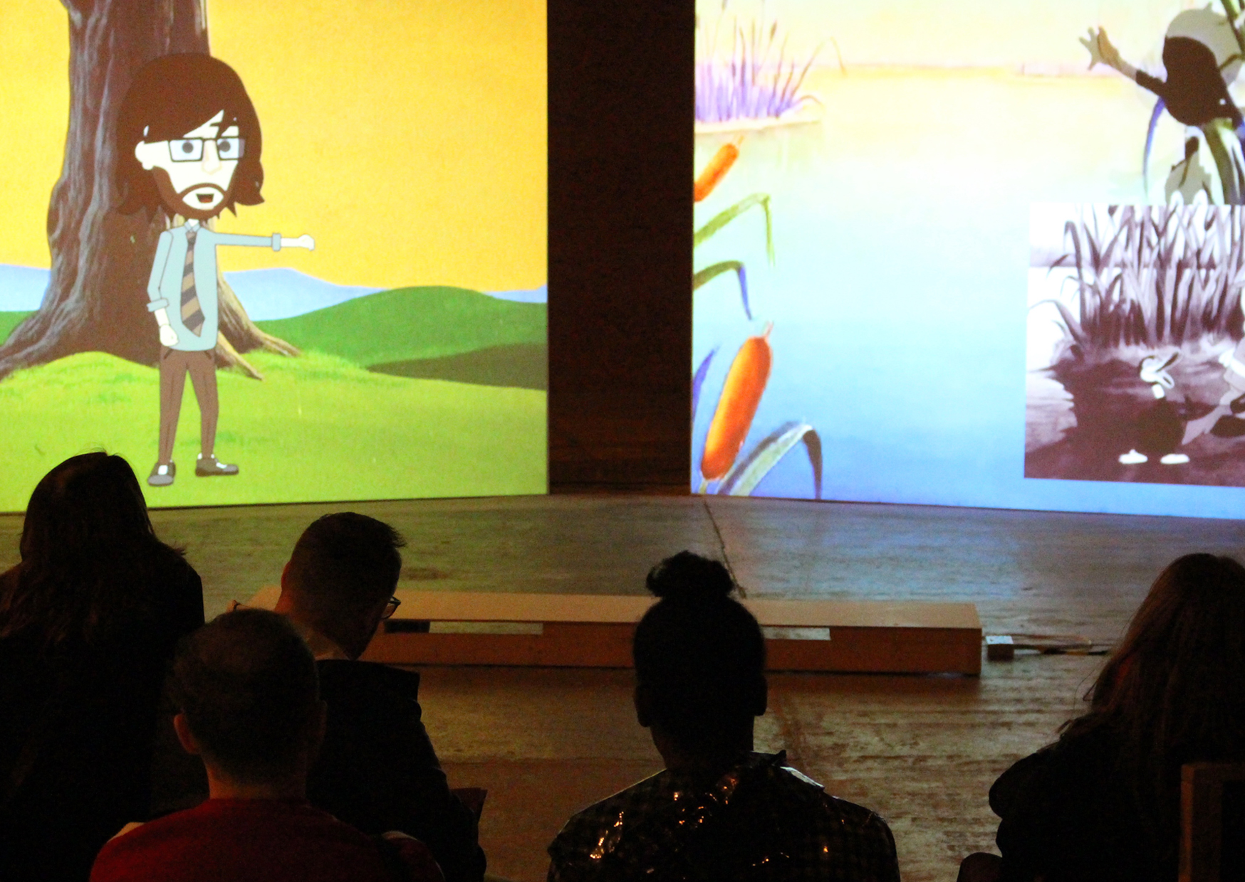
Andy Holden, Laws of Motion in a Cartoon Landscape

Slide 16
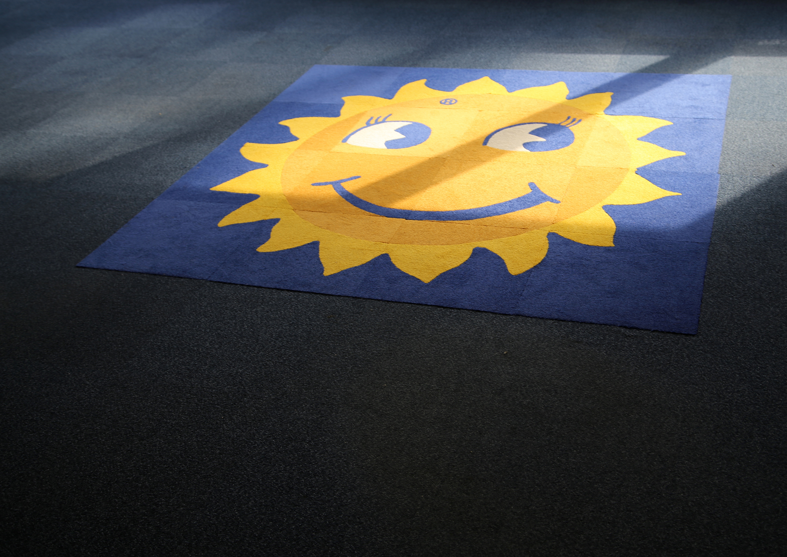
Emma Ha, Mosaic for an Office

Slide 17
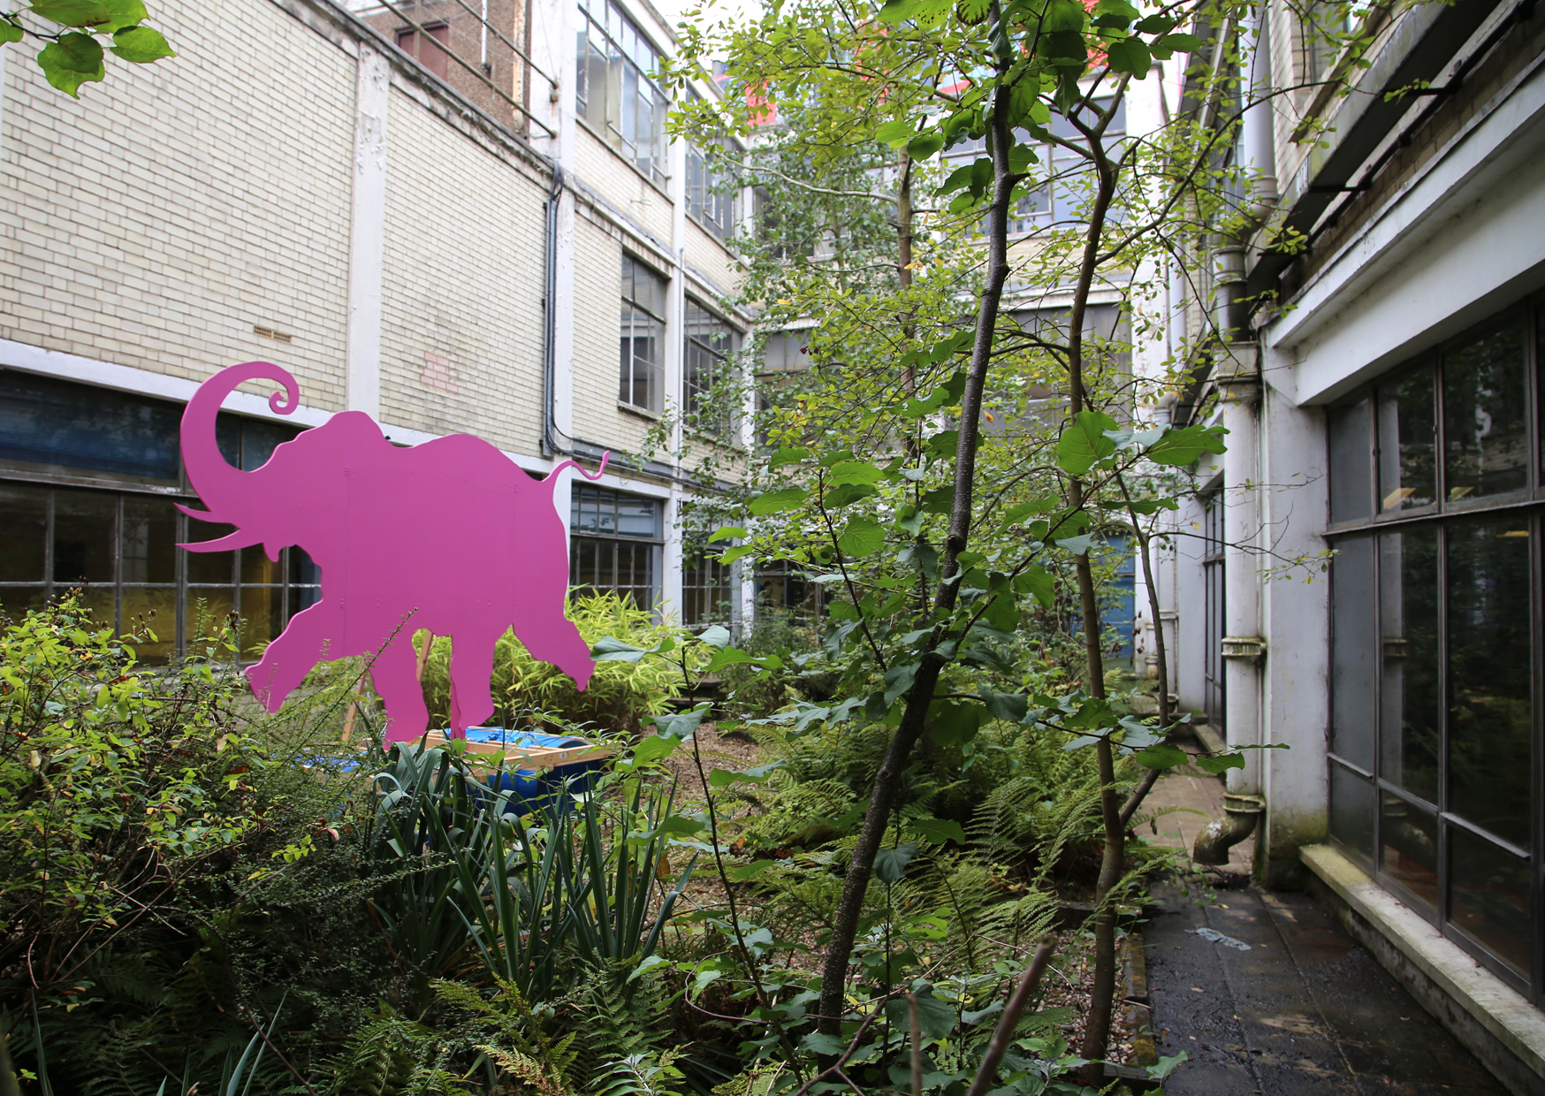
Bermuda Collective, Alcoholism ‘65

Slide 18
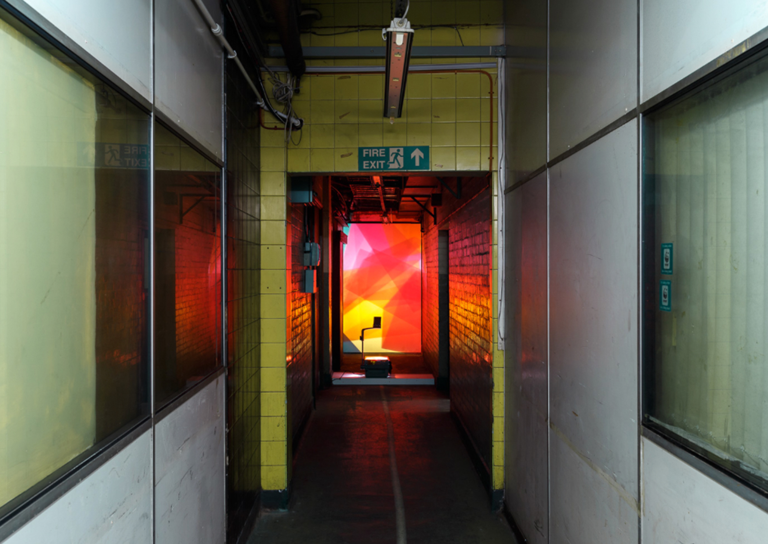
Holly Rowan Hesson, Fold

Slide 19
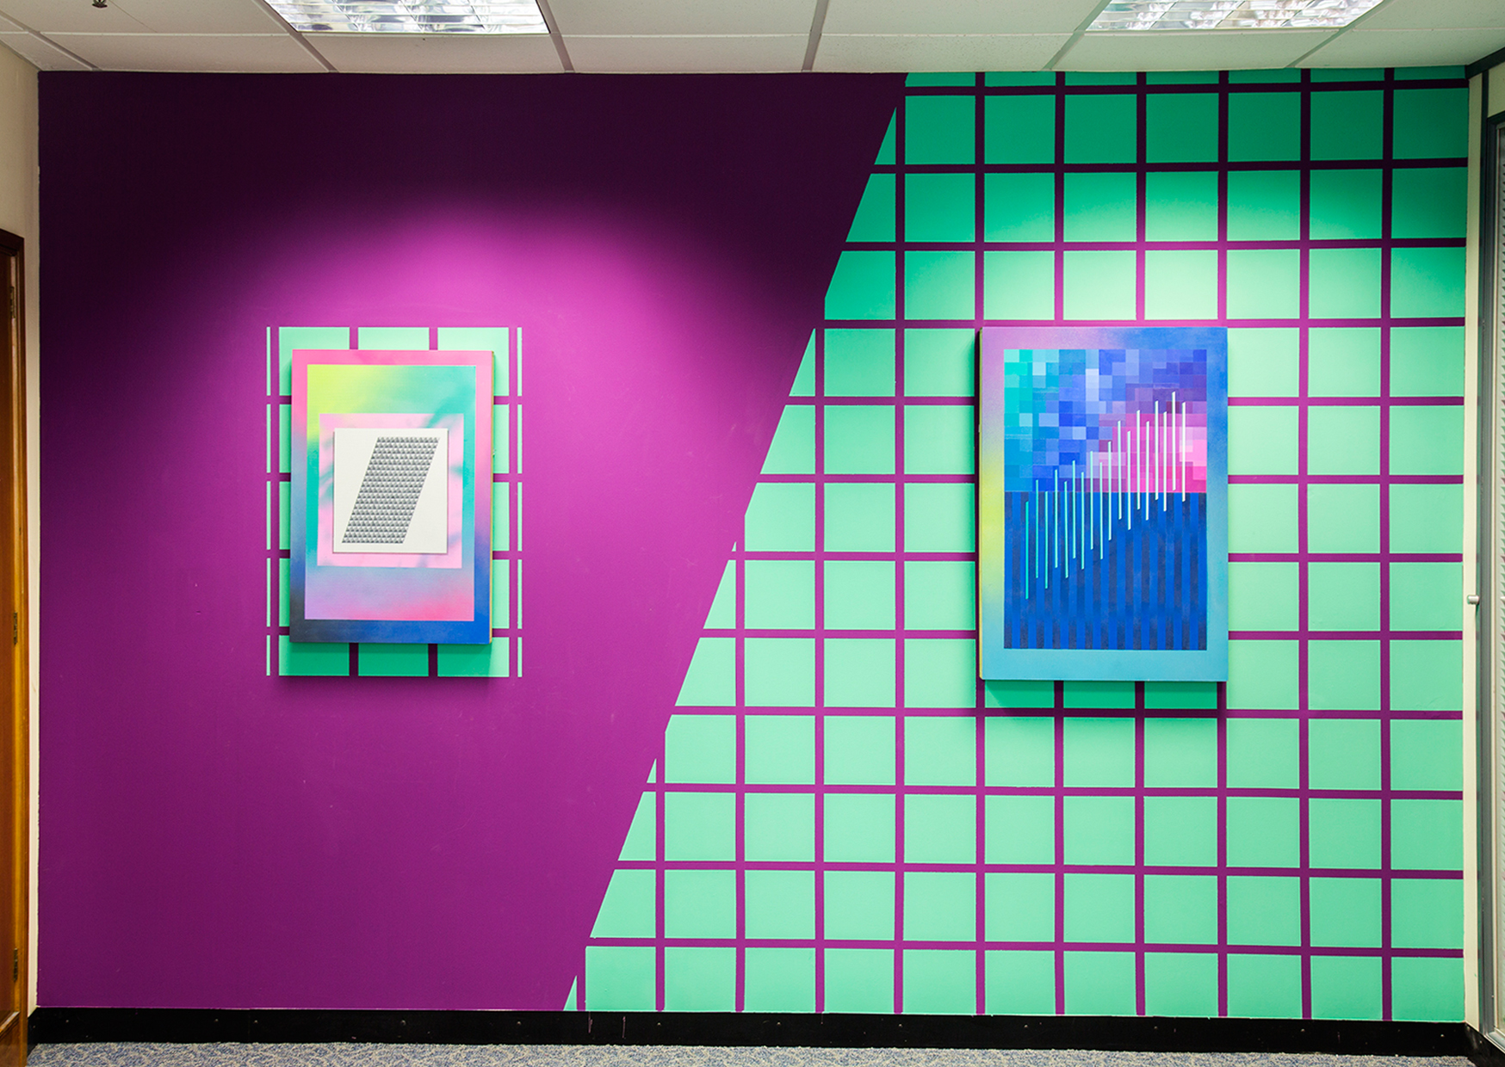
Charley Peters, Editors Suite

Slide 20
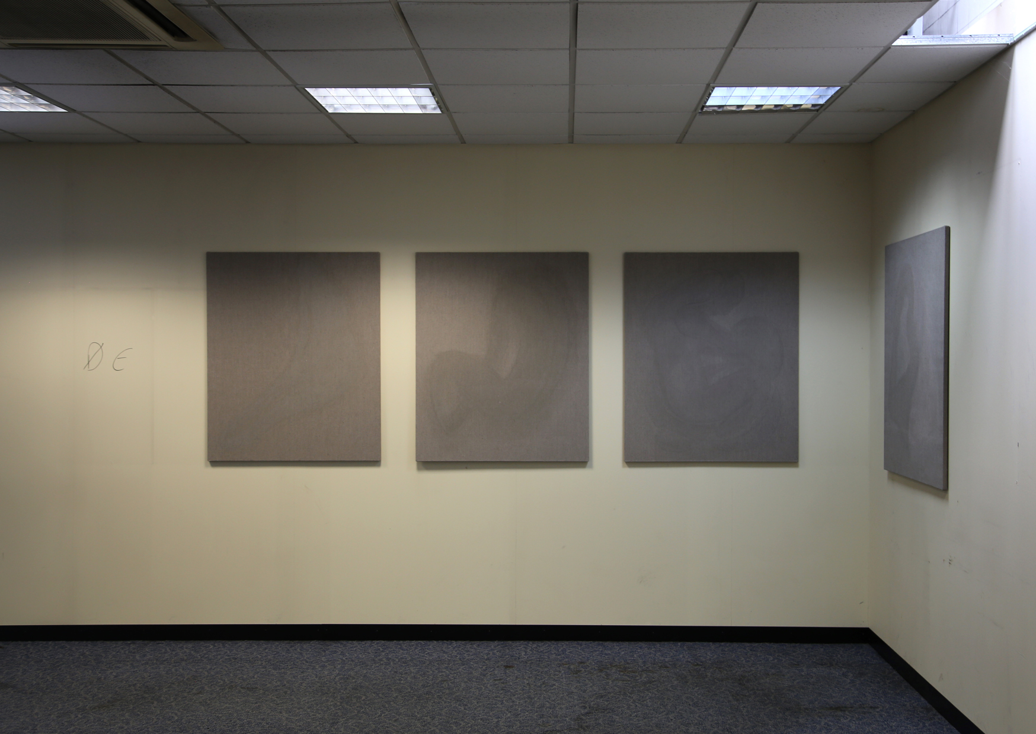
Yelena Popova, Evaporated Paintings

Slide 21
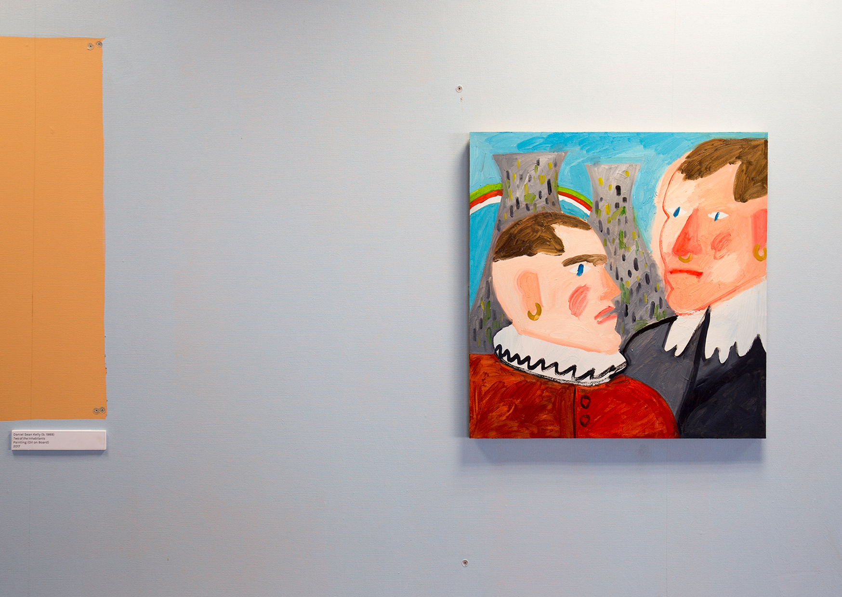
Daniel Sean Kelly, Two of the Inhabitants

Slide 22
